Slide 1

Quant Week 2
2/1/24
Notes:
Complete

Slide 2

Agenda
Icebreaker Question
Brainteasers
Order Book
Market Making
High Frequency Trading
Project

Slide 3
Ice Breaker
Favorite Movie

Slide 4
Brain Teaser - Glass Balls
You are holding two glass balls in a 100-story building
If a ball is thrown out of the window, there is a certain floor X where every throw at or above that floor will break the ball, but the ball will not break if thrown under that.
A ball can be rethrown if it does not break.
At most how many throws will it take to determine X?

Slide 5
Brain Teaser - Answer
Let’s say the maximum amount of throws for a ball is N.
You would have to drop the first ball on the Nth floor.
If that breaks you try floors 1 to N-1 in order
If that does not break you then drop the same ball again on the floor N + N-1
You then have N-2 throws with the other ball to try floors N+1 to N-2
For N throws you would be able to cover N + N-1 + N-2 + … + 1 = N(N-1)/2 (summation formula)
In this case N(N+1)/2 ≥ 100, so N ≥ 14.
It takes at most 14 drops to find floor X.

Slide 6
What is an Order Book?

Slide 7
Order Book
A visual representation of current limit orders
Limit orders: Orders placed to buy or sell at a specific, predetermined price
Market orders: Orders placed to buy at the current available price
Understanding an order book is very important for working in quant (and as a result, interviewing for quant)
The order book is a key component of understanding how market makers make money

Slide 8
Order Book Example
Bid (Volume) | Price | Ask (Volume)
 | 100.03 | 150
 | 100.02 | 100
 | 100.01 | 50
 | 100
60 | 99.99
120 | 99.98
180 | 99.97

Slide 9
Order Book Example
Bid (Volume) | Price | Ask (Volume)
 | 100.03 | 150
 | 100.02 | 100 (SOLD)
 | 100.01 | 50 (SOLD)
 | 100
60 | 99.99
120 | 99.98
180 | 99.97

Slide 10
Order Book Example
Bid (Volume) | Price | Ask (Volume)
 | 100.05 | 250
 | 100.04 | 200
 | 100.03 | 150
 | 100.02
60 | 100.01
120 | 100.00
180 | 99.99

Slide 11
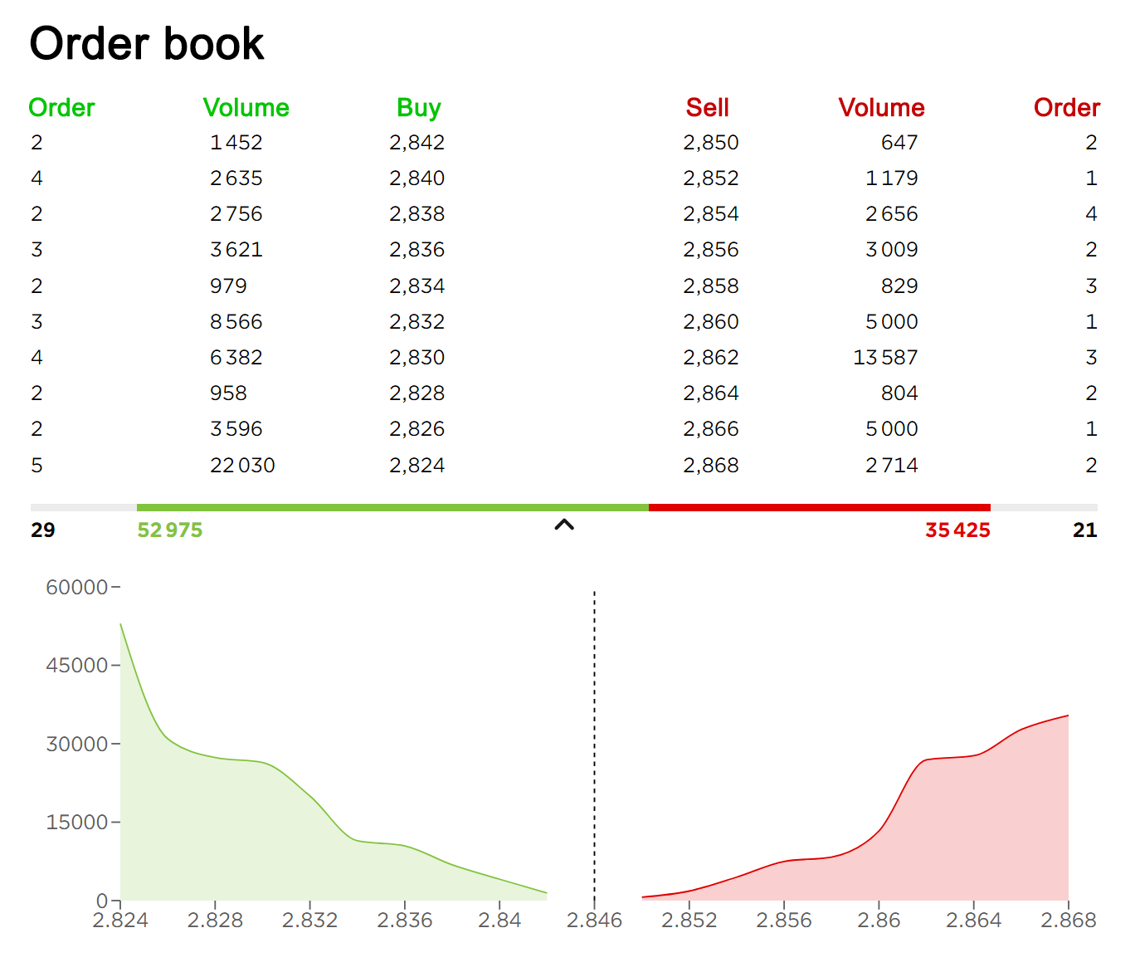
Order Book Example

Slide 12
Market Making

Slide 13
What is Market Making?
In the general sense, a market is a place where you can both buy and sell assets (food, clothing, financial assets, illegal goods, etc.).
Any person who buys or sells a given asset might be a component of a market, but is not considered a market maker. The key feature of a market maker is that they quote both a buy and sell price for an asset.
Some of the more well known market makers are:
Citadel Securities
Jane Street
Virtu Financial
Many large banks (Goldman Sachs, Morgan Stanley)

Slide 14
How do MMs make money?
The goal of a market maker is to quote bid and ask prices such that people buy and sell equal amounts of the asset on both sides.
From the order book example earlier, if there are no large orders, and market orders are trickling in, whoever is making that market makes $0.02 for every pair of offsetting trades.
An interesting feature of this strategy is that market makers remain neutral to moves up or down in the market. As long as their quoted prices result in equal amounts of trading on either side, they profit, regardless of large swings in the market.

Slide 15
High Frequency Trading

Slide 16
What is HFT?
The practice of trading at incredibly high speeds
Driven by highly efficient algorithms written in low level languages or on FPGAs
Requires significant infrastructure and investment
Generally profit per trade is incredibly low, but the sheer volume of trades results in large profits
HFTs are incredibly secretive about their strategies. As soon as another firm discovers their strategy, the pseudo-arbitrage opportunity closes, and it is generally no longer profitable.
As a result, many employees are required to sign NDAs and long non-competes (2+ years).

Slide 17
Basic HFT Strategies

Slide 18
Arbitrage
Arbitrage describes an opportunity in which an individual can buy an asset, and immediately sell it for a higher price.
The most common example is in ForEx markets, but it can also occur between exchanges.
Because of the competition present, these opportunities rarely exist, and are closed quickly when they do.

Slide 19
Latency Arbitrage
Latency Arbitrage is the most pure example of HFTs’ advantage over other traders/investors.
Suppose a hedge fund needs to buy a large chunk of a stock, and there isn’t enough liquidity in the order book
A HFT firm sees the hedge fund buying up all of this stock (in the form of rapid price movements) and starts to buy all of the stock on other exchanges
As a result, the hedge fund now has to pay a higher price, and the difference is the HFT firm’s profit

Slide 20
Event Arbitrage
Event arbitrage is when a HFT makes use of its speed to react to news stories faster than other players in the market
With the Houthi attacks on shipping lanes, ships now have to sail around the Horn of Africa, instead of cutting through the Red Sea
This results in significantly higher oil costs
An HFT firm might see this and be able to react far more quickly than other players

Slide 21
Statistical Arbitrage
Essentially a more complicated version of pairs trading
Firms look at correlation between assets, and use highly technical models to bet on the convergence or divergence of certain assets or indicators
Generally more common nowadays

Slide 22
Project Discussion/Work Time
Notes:
Idea:
We’ll write the platform to make and conduct trading strategies.
You guys will write and implement the strategies, test them on prior data
Alternate for more software-oriented people you guys could also make the platform
We can do this in python/C++, if python use numPy and Yahoo Finance data
Use matplotlib plot graphs, show that in pdf/md/html file through github

Slide 23
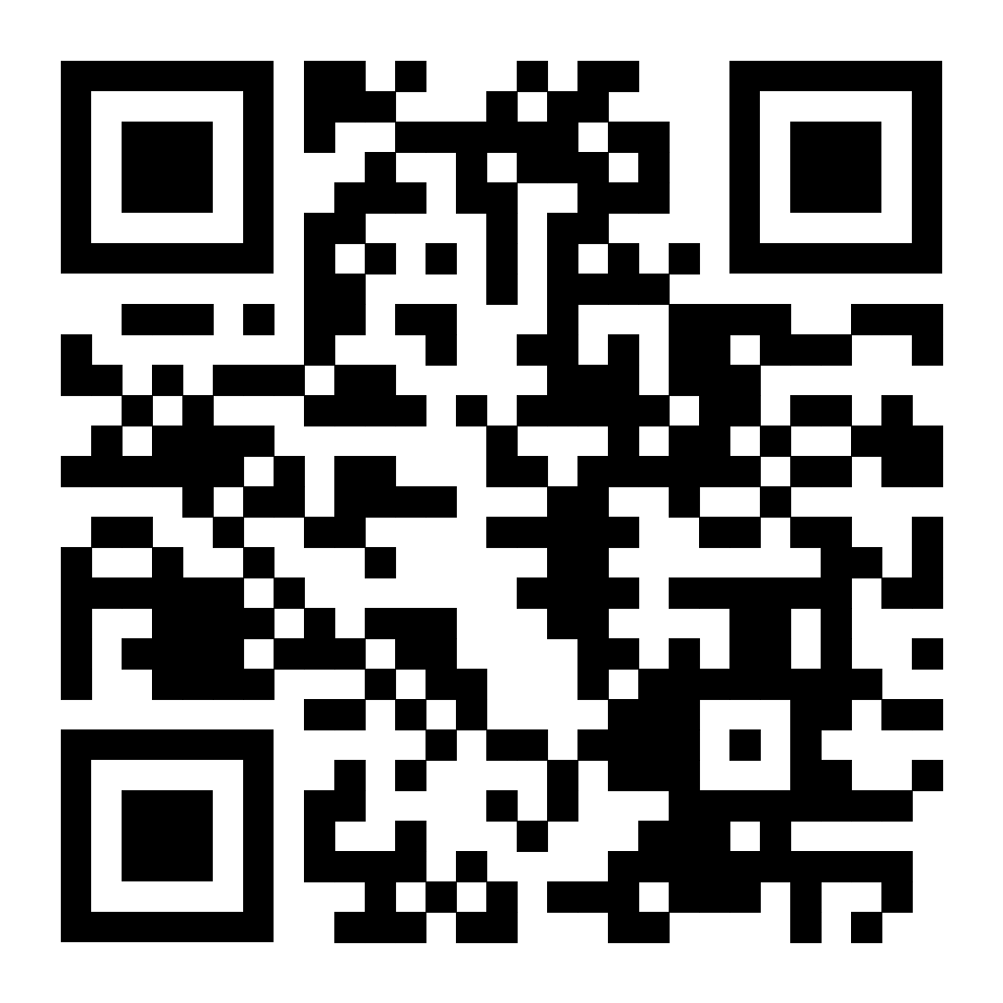
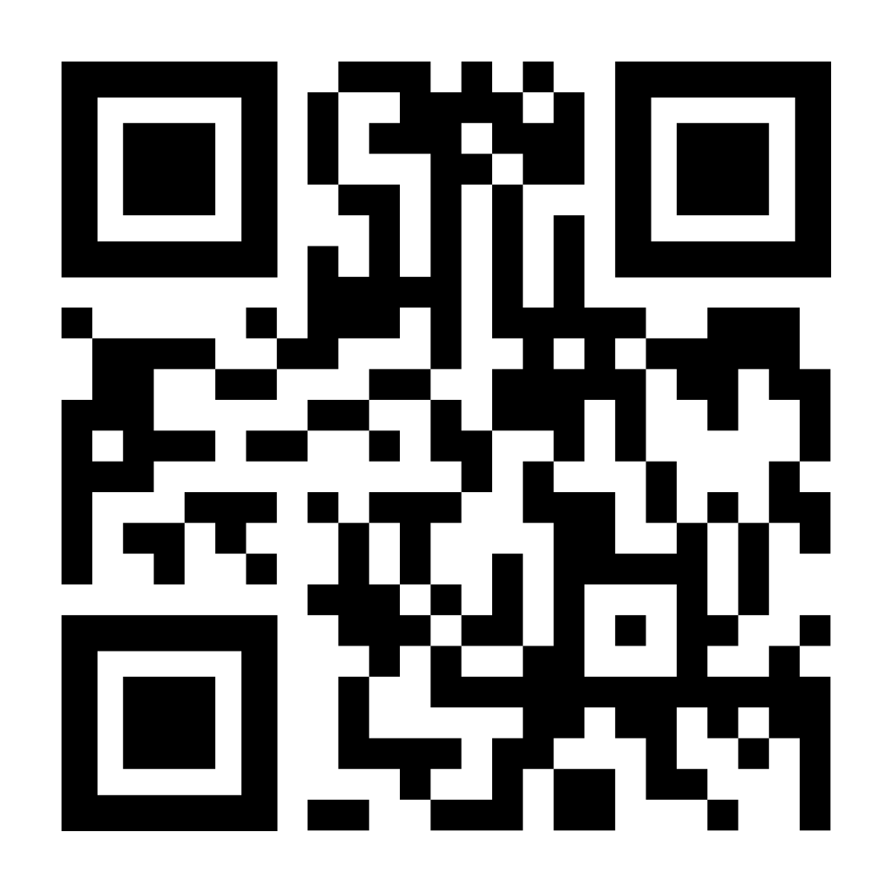
Attendance Form
This one
Link to Onboarding Document, Slack and Team Folder
https://forms.gle/zSxTW3EgUcRMSiL3A

